Slide 1
Otterly Secure, Store, and Rotate IAM Access Keys
with AWS Secrets Manager
Tracy Pierce
Sr. Cloud Support Engineer
Sophoclis Hadjimichael
Cloud Support Engineer II

Slide 2


What to Expect from the Session
Customers expect security of their data. This includes secure storage of IAM User Access Keys. While not possible with IAM itself, we can use a combination of IAM, Secrets Manager, Lambda, and KMS to enforce rotation and encrypted storage of these Access Keys.

Slide 3

What to Expect from the Session
Customers expect security of their data. This includes secure storage of IAM User Access Keys. While not possible with IAM itself, we can use a combination of IAM, Secrets Manager, Lambda, and KMS to enforce rotation and encrypted storage of these Access Keys.

Slide 4
What to Expect from the Session
Customers expect security of their data. This includes secure storage of IAM User Access Keys. While not possible with IAM itself, we can use a combination of IAM, Secrets Manager, Lambda, and KMS to enforce rotation and encrypted storage of these Access Keys.

Slide 5

What to Expect from the Session
Customers expect security of their data. This includes secure storage of IAM User Access Keys. While not possible with IAM itself, we can use a combination of IAM, Secrets Manager, Lambda, and KMS to enforce rotation and encrypted storage of these Access Keys.

Slide 6

What to Expect from the Session
Customers expect security of their data. This includes secure storage of IAM User Access Keys. While not possible with IAM itself, we can use a combination of IAM, Secrets Manager, Lambda, and KMS to enforce rotation and encrypted storage of these Access Keys.

Slide 7
Otterly Secure, Store, and Rotate IAM Access Keys with AWS Secrets Manager

Slide 8
What’s the diff between SSM and ASM?
Before we get too far in, I know this will come up. What’s the deal with SSM (AWS Systems Manager) and ASM (AWS Secrets Manager)? Why is one better than the other? Why should I use one over the other?
Notes:
The answer is – neither
SSM – Is a service used to store and retrieve configuration data, including secrets. It’s free to use and gives you the control to build and schedule your own rotation. It also has CloudFormation support and access logging via CloudTrail. And it’s available to anyone!
ASM – Is a service specifically built to manage the lifecycle management for secrets. The cost is more, but the value received is increased as well. AWS will manage your secret rotation, which helps you meet security and compliance requirements. It has full access logging via CloudTrail and CloudFormation on roadmap. This product was really focused on ENT customers.
There are reasons to use either service for your secret needs. One is not necessarily better than the other. We’re just giving customers more options to meet their needs with different features.

Slide 9

What’s the diff between SSM and ASM?
Before we get too far in, I know this will come up. What’s the deal with SSM (AWS Systems Manager) and ASM (AWS Secrets Manager)? Why is one better than the other? Why should I use one over the other?
Notes:
The answer is – neither
SSM – Is a service used to store and retrieve configuration data, including secrets. It’s free to use and gives you the control to build and schedule your own rotation. It also has CloudFormation support and access logging via CloudTrail. And it’s available to anyone!
ASM – Is a service specifically built to manage the lifecycle management for secrets. The cost is more, but the value received is increased as well. AWS will manage your secret rotation, which helps you meet security and compliance requirements. It has full access logging via CloudTrail and CloudFormation on roadmap. This product was really focused on ENT customers.
There are reasons to use either service for your secret needs. One is not necessarily better than the other. We’re just giving customers more options to meet their needs with different features.

Slide 10
What’s the diff between SSM and ASM?
Before we get too far in, I know this will come up. What’s the deal with SSM (AWS Systems Manager) and ASM (AWS Secrets Manager)? Why is one better than the other? Why should I use one over the other?
Notes:
The answer is – neither one is better than the other.
SSM – Is a service used to store and retrieve configuration data, including secrets. It’s free to use and gives you the control to build and schedule your own rotation. It also has CloudFormation support and access logging via CloudTrail. And it’s available to anyone!
ASM – Is a service specifically built to manage the lifecycle management for secrets. The cost is more, but the value received is increased as well. AWS will manage your secret rotation, which helps you meet security and compliance requirements. It has full access logging via CloudTrail and CloudFormation on roadmap. This product was really focused on ENT customers.
There are reasons to use either service for your secret needs. One is not necessarily better than the other. We’re just giving customers more options to meet their needs with different features.

Slide 11
So what is it customers want?
Notes:
Besides a Security Otter

Slide 12
So what is it customers want?
Secure, consistent, and encrypted storage of IAM User Access Keys.
Notes:
They want a way to ensure IAM User Access Keys are kept safe. We hear so many stories in support of Access Keys being compromised as they were left in GitHub code, emailed to vendors or even 3rd parties. And, if one set of keys are compromised, how do you know other’s aren’t? So, it’s been highly requested to have a method that can securely store encrypted Access Keys, in a way that is consistently available.

Slide 13
So what is it customers want?
Secure, consistent, and encrypted storage of IAM User Access Keys.
Enforced Access Key rotation when keys reach a certain age.
Notes:
Aside from the encrypted, consistent storage, customers also want to have the option to enforce Access Key rotation. Security Best Practices states you should always use Roles or Federation to ensure temporary Access Keys are used or created. However, there are always going to be special cases where static Access Keys are necessary. But, you definitely don’t want them hanging around for years at a time w/out changing. So, enforced rotation at a customer specified timeframe was the second most requested feature.

Slide 14
So what is it customers want?
Secure, consistent, and encrypted storage of IAM User Access Keys.
Enforced Access Key rotation when keys reach a certain age.
Easy retrieval of these keys by the IAM Users w/out need for
emails, messaging, etc.
Notes:
And finally, an easy way for IAM Users to access these new credentials. Customers didn’t want to go through the mess of setting up emails or phone numbers for SNS messaging of these credentials, as then you void the first request. Having these sit in an email Inbox or phone isn’t very secure. So, a method was necessary to ensure these could be kept in a secure location, but also be easily retrieved by the specific User. And they should only have access to request their own IAM User credentials. So, what do we do?

Slide 15

Otters to the Rescue!
ListAccessKeys API
Notes:
Well, it’s otters to the rescue of course! Patrick, the Security Admin for Ottersby Inc. creates a Lambda Function that will first, run the ListAccessKeys API.

Slide 16
Otters to the Rescue!
ListAccessKeys API
Active Status
CreateDate
Notes:
With this information it will parse the Access Key Metadata to look for an “Active” status and the “CreateDate” information.

Slide 17

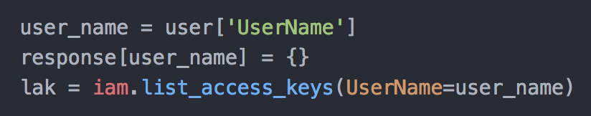
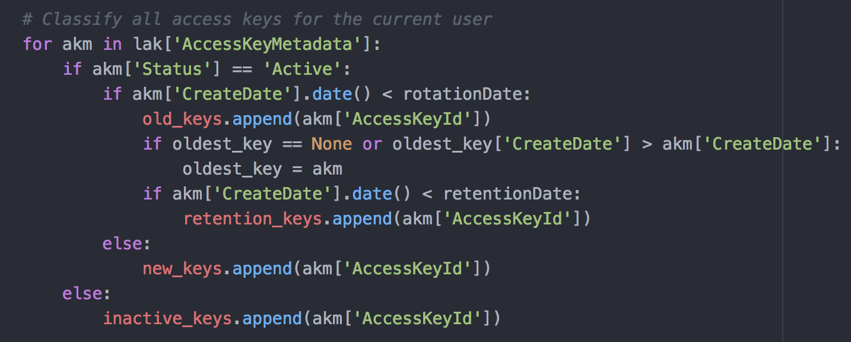
ListAccessKeys & Metadata

Slide 18
Otters to the Rescue!
ListAccessKeys API
Active Status
CreateDate
Create new Access Key pair
Notes:
If the Access Keys have a CreateDate older than 30 days (or the timeframe your security policy requires), the Function will create a new Access Key pair.

Slide 19
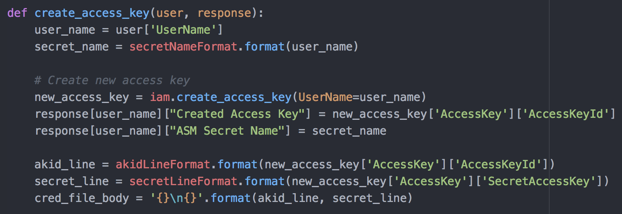

Create New Access Key Pair

Slide 20
Otters to the Rescue!
ListAccessKeys API
Active Status
CreateDate
Create new Access Key pair
Store in Secrets Manger
Ex. = User_${aws:username}_ AccessKey
Notes:
Next, we store a copy of the Access Keys into Secrets Manager. These will be saved with the name “User_UserName_AccessKey”. The ”UserName” will actually be replaced with the IAM Username. Access to their own specific secret is done using variables in the IAM policy. We use the ${aws:username} variable, as it can pull from Console and CLI, which makes creating permissions extremely simply. One Managed Policy can take care of all permissions necessary for these Users to retrieve their credentials.

Slide 21
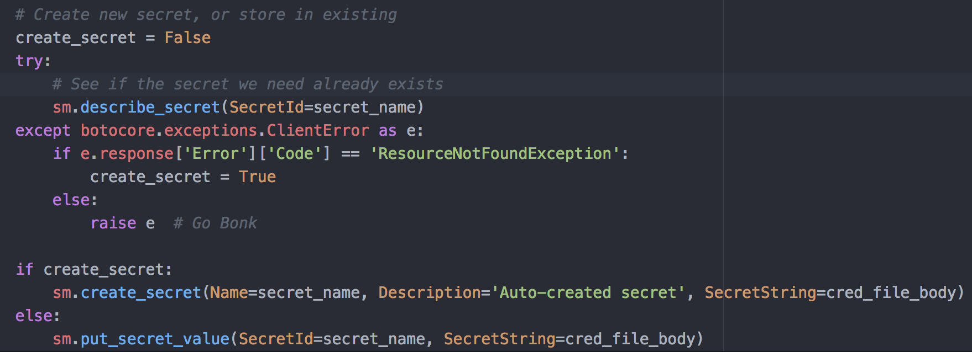

Update or Create Secret

Slide 22
Otters to the Rescue!
ListAccessKeys API
Active Status
CreateDate
Create new Access Key pair
Store in Secrets Manger
Ex. = User_${aws:username}_ AccessKey
Delete the old Access Key pair three days later
Notes:
The last bit of action to complete the rotation, is to remove the old Access Key pair a few days after the new ones are created. This will give the user time to retrieve their new credentials and configure their CLI with them.

Slide 23
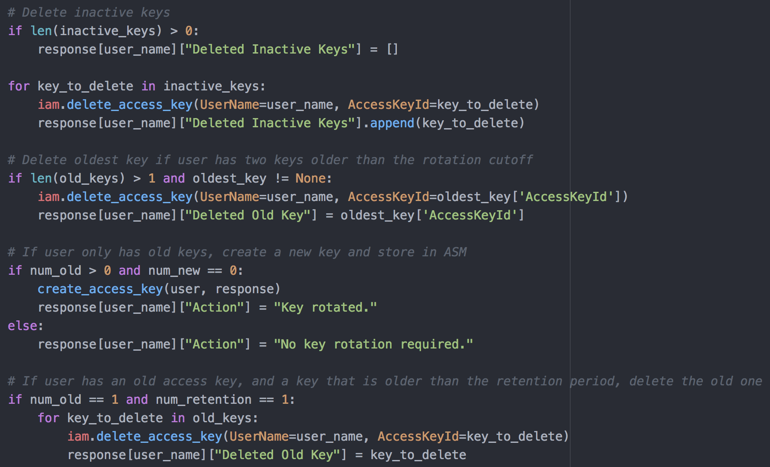

Delete Old Access Key Pair

Slide 24
And now a demo! Woot woot!
L
I
V
E
ish
D
E
M
O

Slide 25
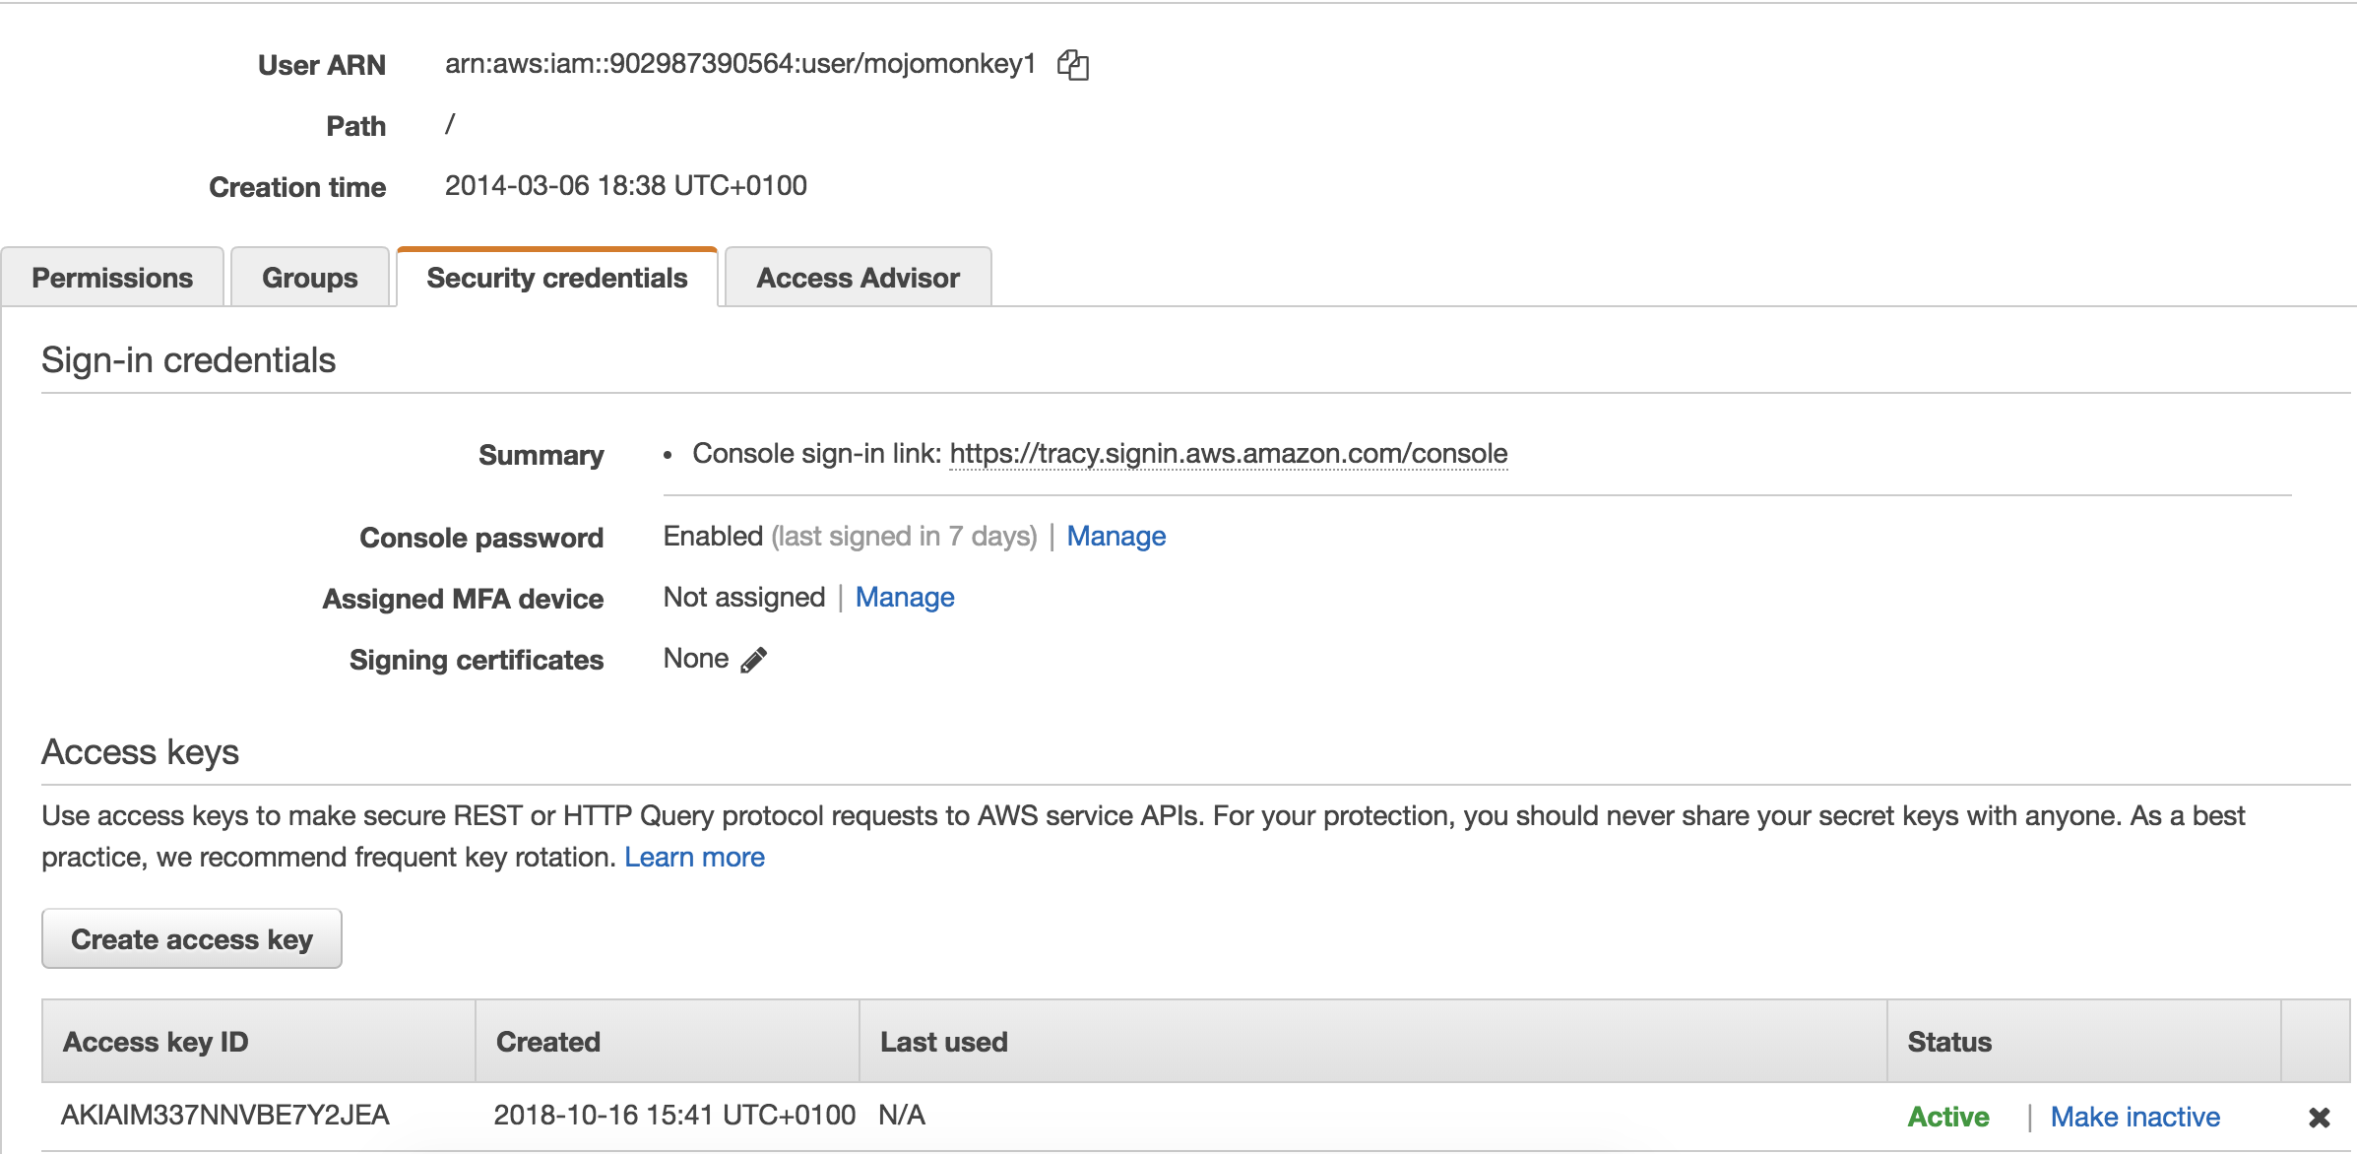
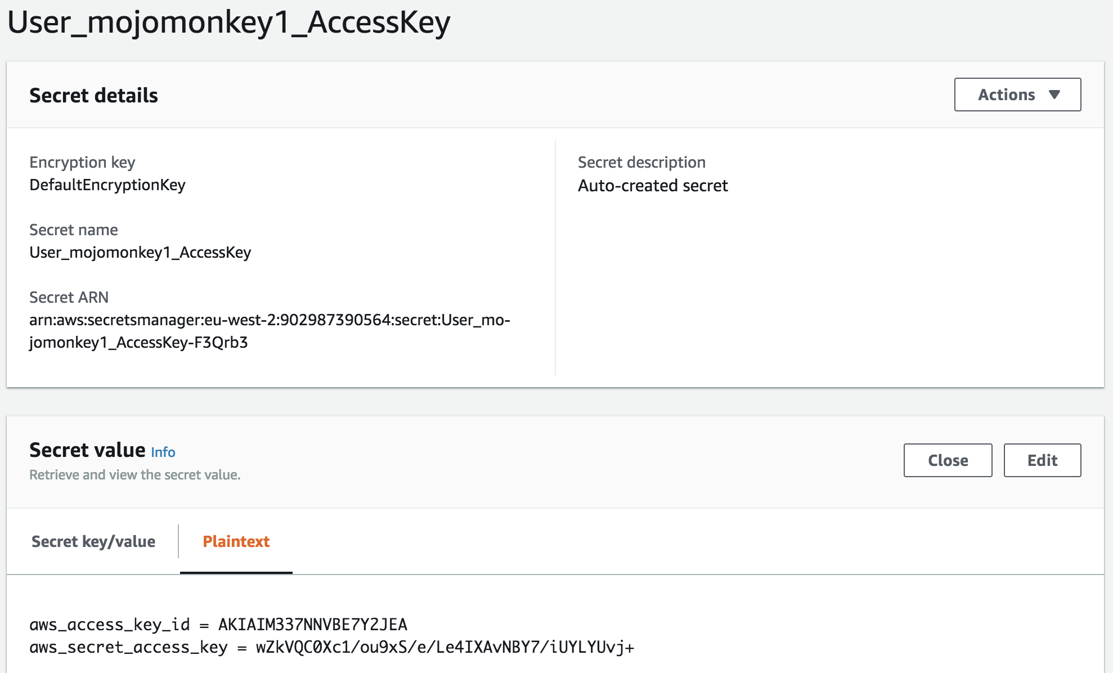
User 1 – Mojomonkey1 Before

Slide 26
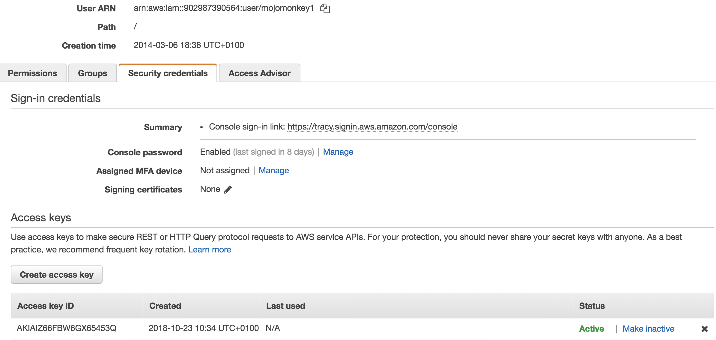
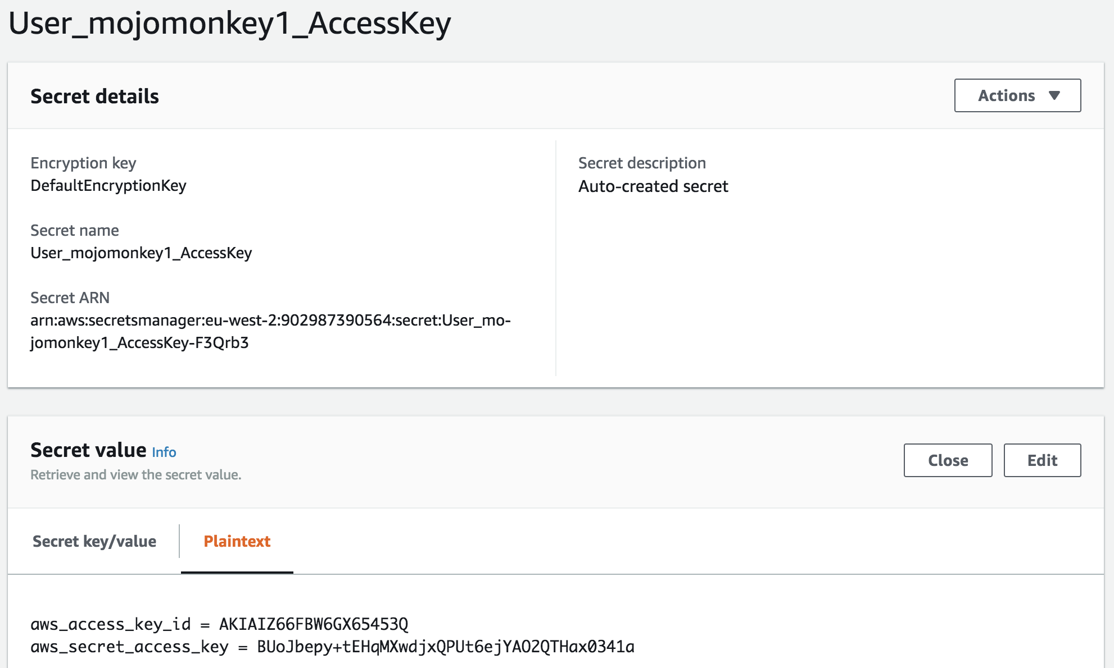
User 1 – Mojomonkey1 After

Slide 27
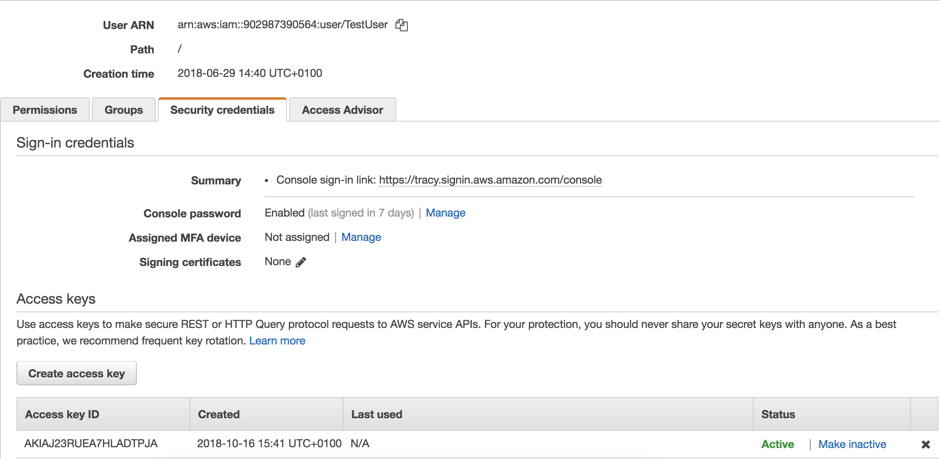
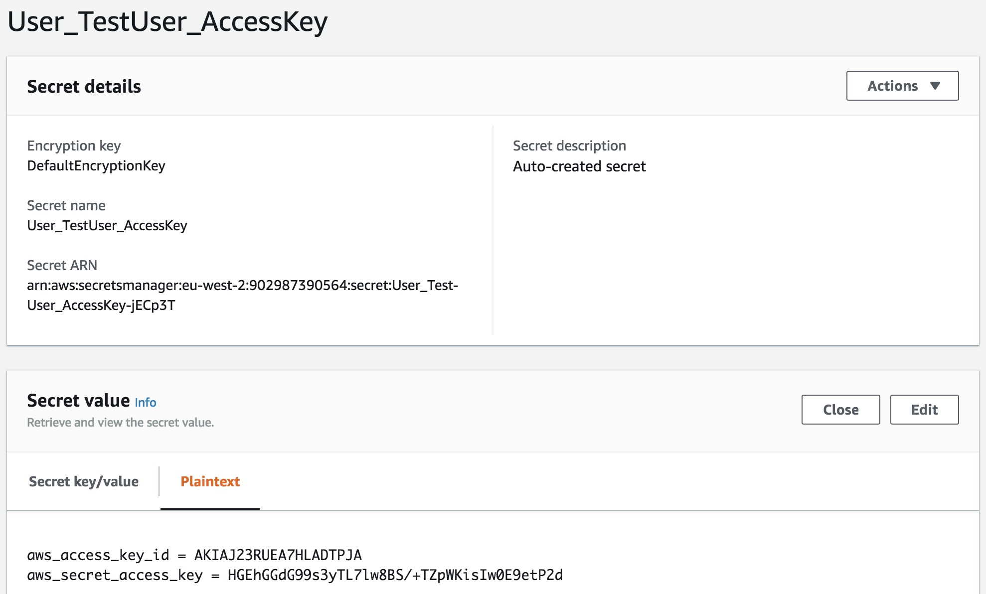
User 1 – TestUser Before

Slide 28

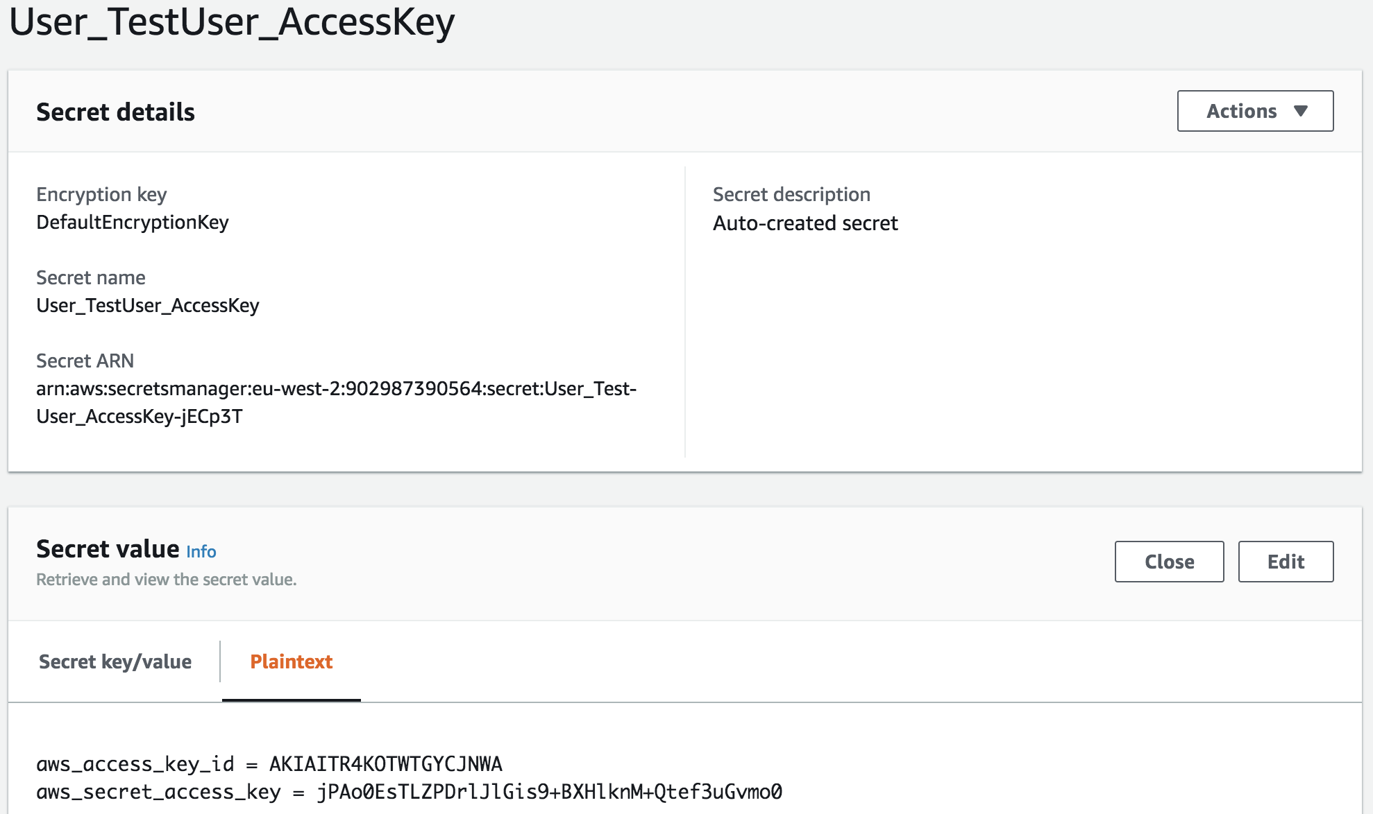
User 1 – TestUser After

Slide 29
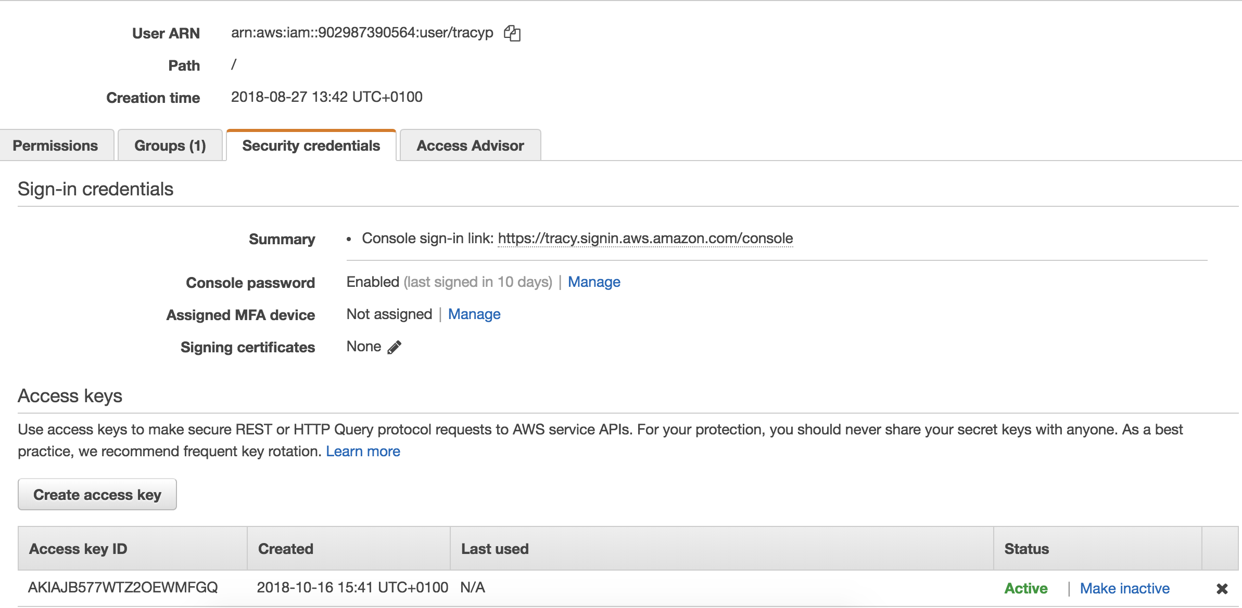
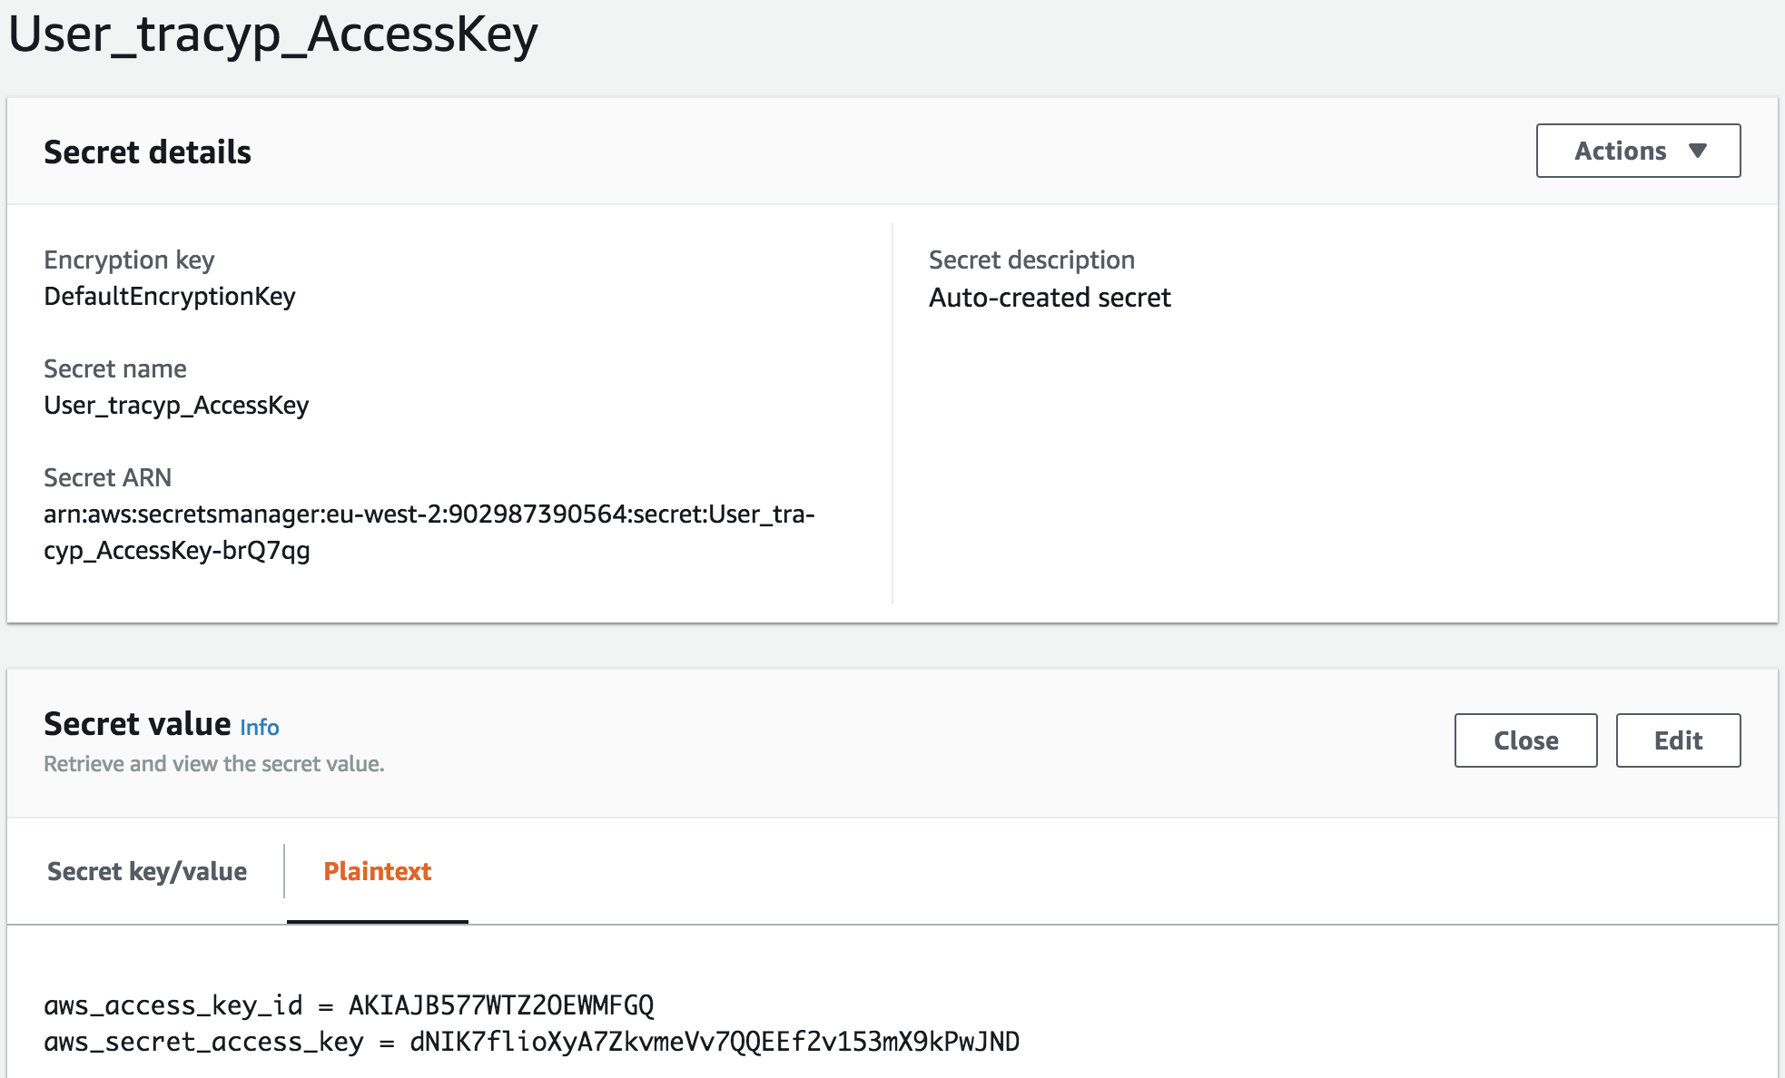
User 1 – tracyp Before

Slide 30
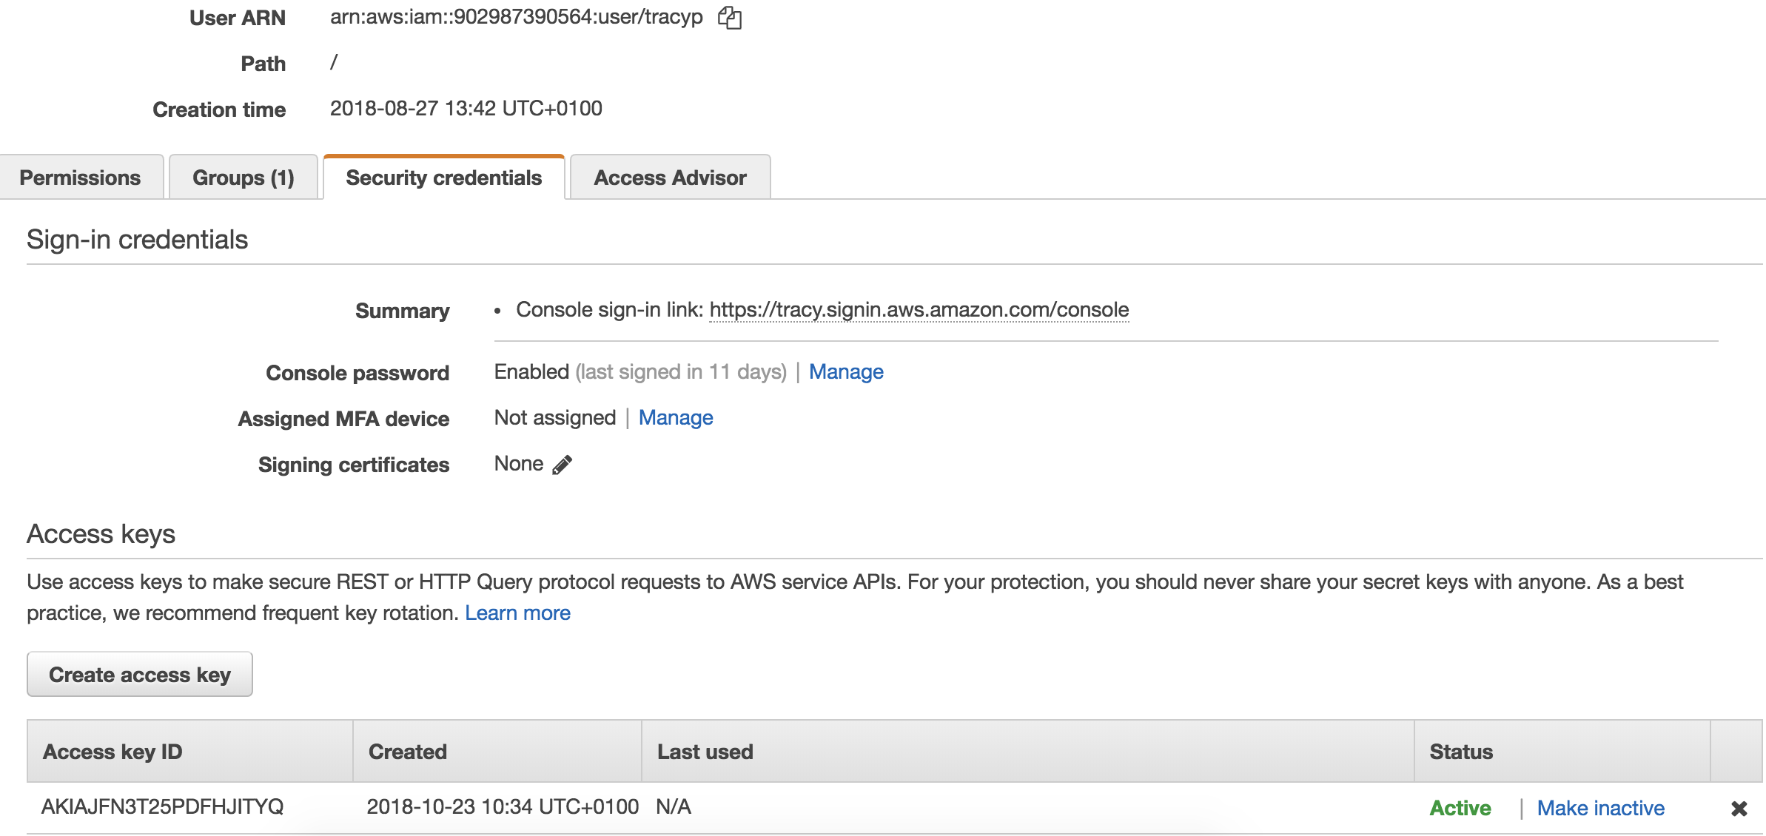
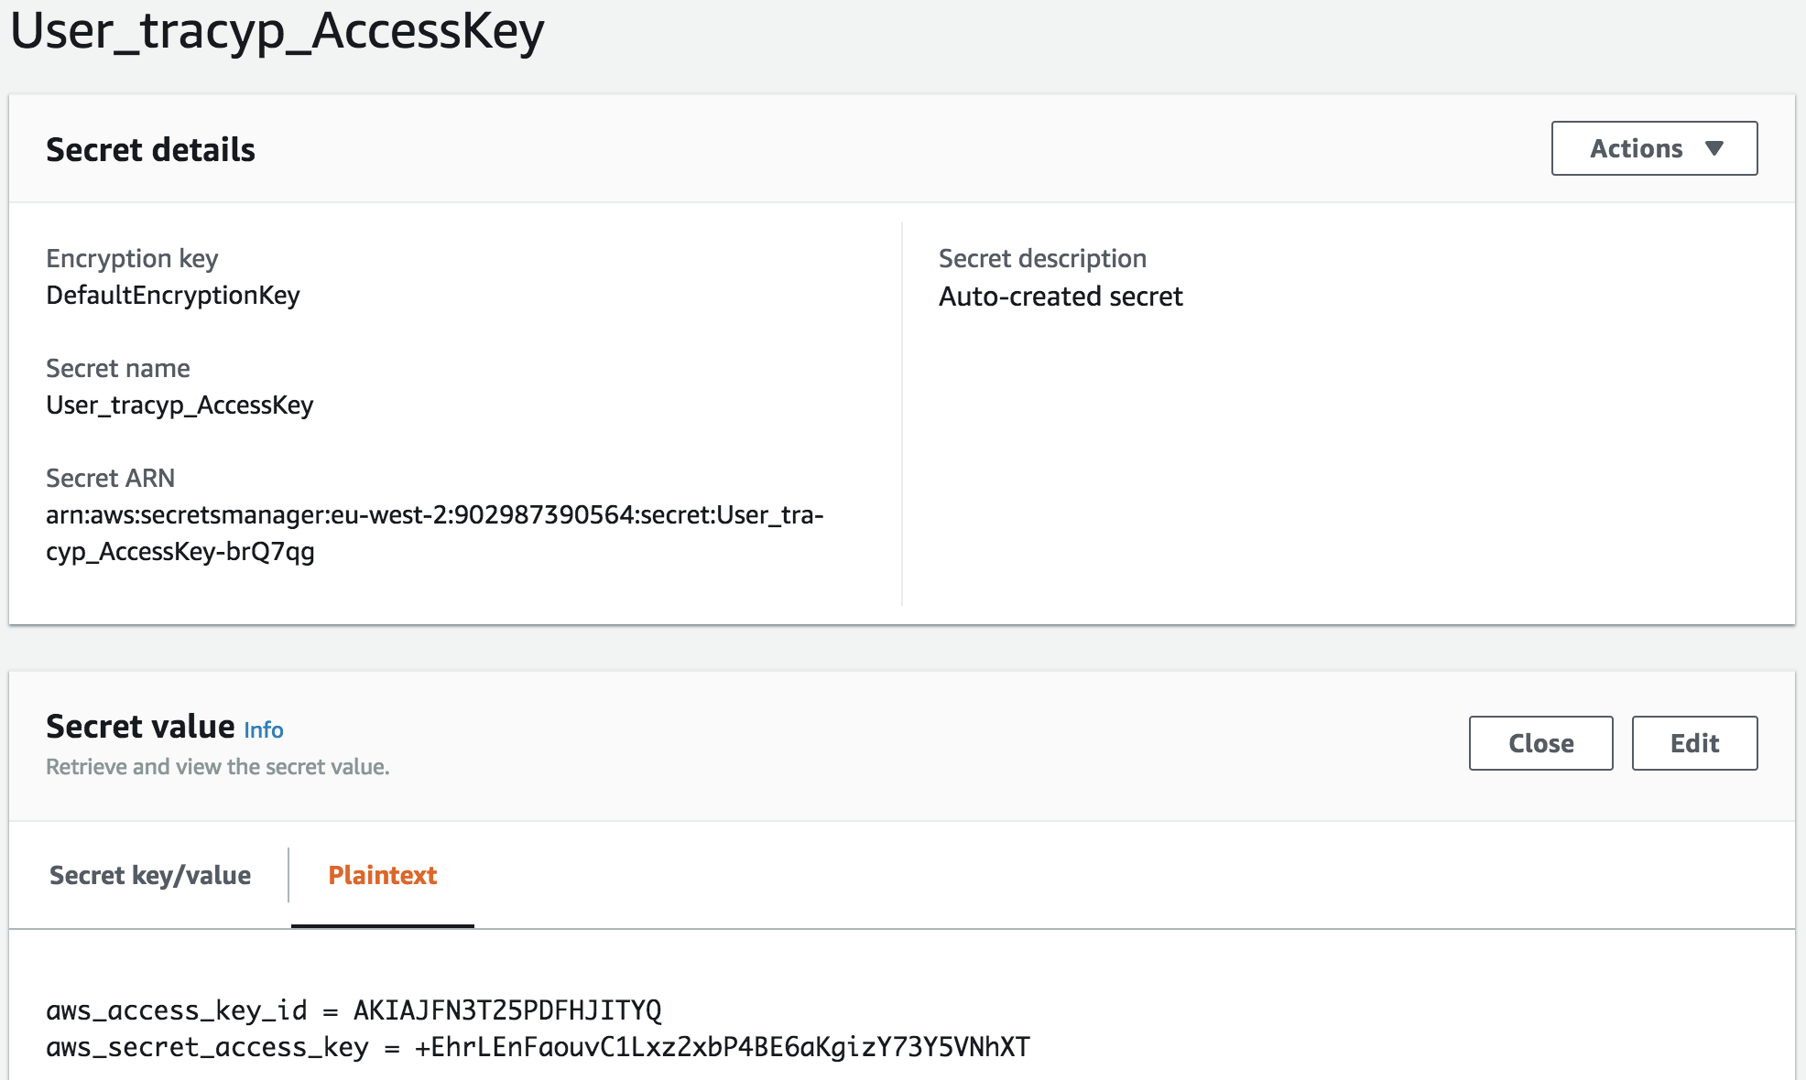
User 1 – tracyp After

Slide 32


